Slide 1

Azure Fundamentals
UNIT-1
Cloud Concepts

Slide 2
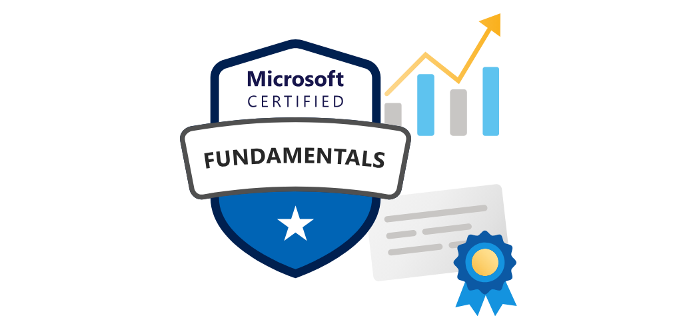
Introduction to Microsoft Azure Fundamentals
What are Azure Fundamentals?
Azure Fundamentals encompass the essential understanding of Microsoft Azure, covering core cloud concepts, basic services, security, pricing, and management.
What exactly does Azure provide?
Web Services
Virtualized Computing
Cloud Resources
Advanced Tech Integration
Continuous Evolution

Slide 3
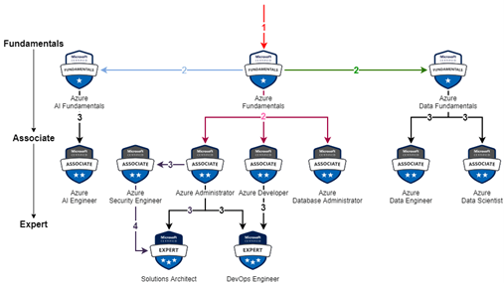
Introduction to Microsoft Azure Fundamentals
What is the roadmap to do Azure certification?

Slide 4
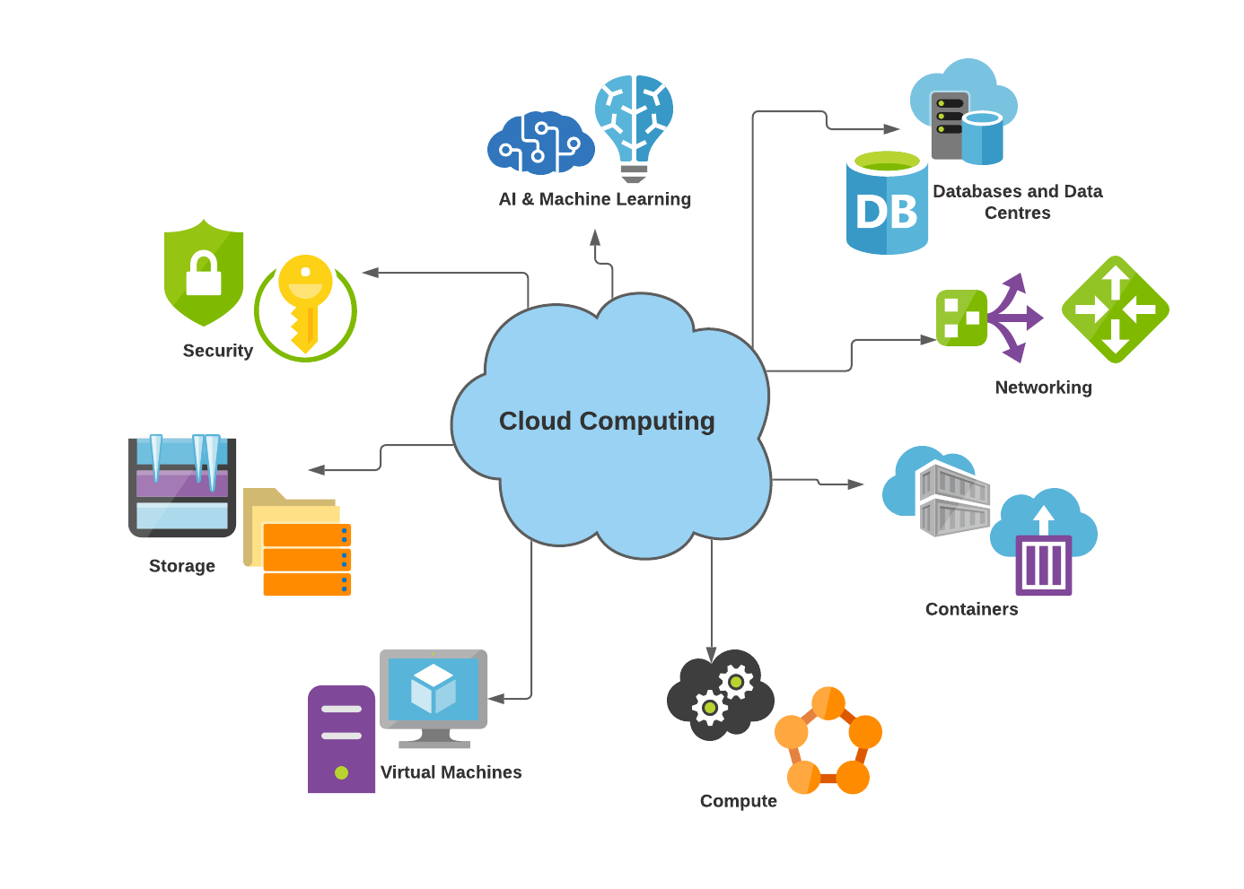
What is Cloud Computing?
Cloud computing delivers computing services over the internet, providing access to various resources without needing physical infrastructure ownership.
What is Cloud Computing?
What does Cloud Computing provide?
https://ostechnix.com/wp-content/uploads/2021/12/Cloud-Computing.png

Slide 5
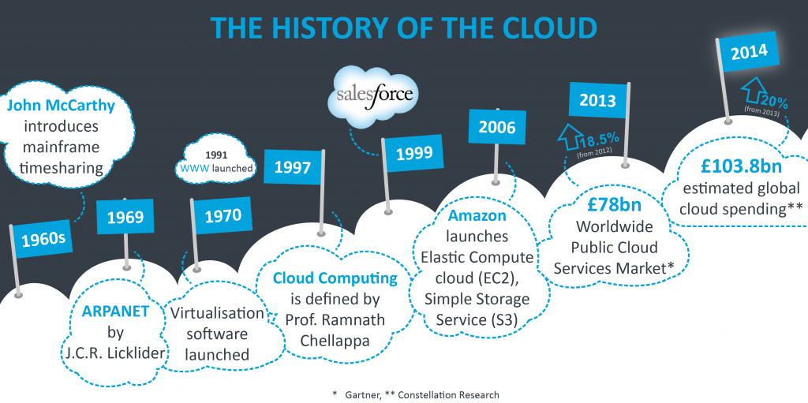
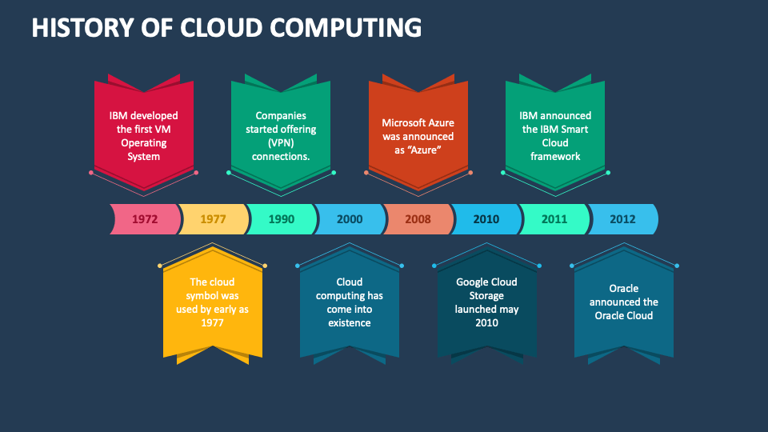
History of Cloud Computing
Ref: https://cloudcomputing521.files.wordpress.com/2017/05/the-history-of-the-cloud-1024x511.png
Ref

Slide 6
What does cloud computing refer to?
a) Storing data on physical servers
b) Delivering computing services over the internet
c) Using local hard drives for data storage
d) Accessing data via USB drives
Which statement best defines cloud computing history?
a) Cloud computing began in the late 20th century.
b) Cloud computing started with the launch of Microsoft Office.
c) The concept of cloud computing emerged in the 21st century.
d) Cloud computing dates back to the early days of the internet.
Which technology is not associated with cloud computing?
a) Virtualization
b) Blockchain
c) Artificial Intelligence
d) Internet of Things (IoT)

Slide 7
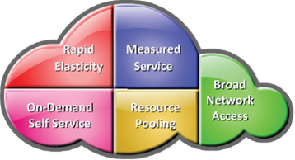
Basic Principle of Cloud Computing:
What are Basic Principles of Cloud?
https://2.bp.blogspot.com/-BvNzPd3MNgQ/UxFmWLnmuxI/AAAAAAAAANA/9Q5sYFcgF2Q/s1600/charaterstics+of+cloud.png

Slide 8
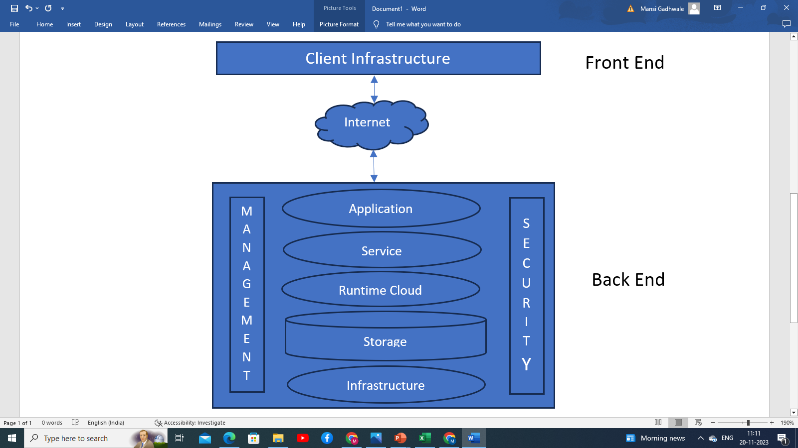
Cloud Computing Architecture
The front end is used by the client.
The back end is used by the service provider.

Slide 9
What does on-demand self-service mean in cloud computing?
A) Service provider access only
B) Pay-as-you-go model
C) Immediate access without human intervention
D) Limited service access
Which component is responsible for providing APIs and managing cloud services in a cloud architecture?
A) Front End
B) Back End
C) Middleware
D) Hypervisor
What does the term 'Middleware' signify in cloud architecture?
A) Software connecting Front End and Back End
B) Security protocols
C) Physical server configurations
D) Data storage mechanisms

Slide 10
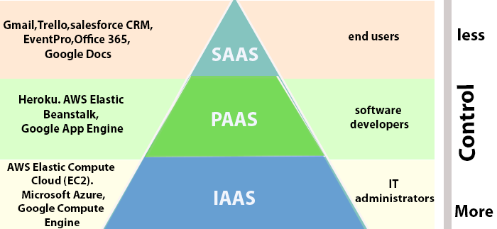
The Shared Responsibility Model
Before moving toward a shared responsibility model, you should know cloud services.
https://static.javatpoint.com/tutorial/microsoft-azure/images/introduction-to-cloud-computing-4.png

Slide 11
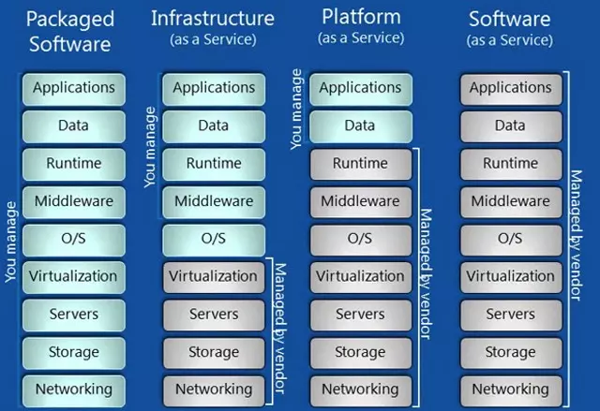
The Shared Responsibility Model
https://zegsolutions.com/wp-content/uploads/2020/10/iaas-paas-saas.jpg

Slide 12
According to the shared responsibility model, who is responsible for securing the cloud infrastructure?
A) Cloud service provider (CSP)
B) Cloud users
C) Both CSP and users jointly
D) Independent regulatory agencies
Which cloud service model provides on-demand access to virtualized computing resources over the internet?
A) Infrastructure as a Service (IaaS)
B) Platform as a Service (PaaS)
C) Software as a Service (SaaS)
D) Function as a Service (FaaS)
What characterizes a Software as a Service (SaaS) model?
A) Offers virtualized infrastructure
B) Provides access to applications over the internet
C) Allows customization of underlying hardware
D) Offers low-level APIs for developers

Slide 13
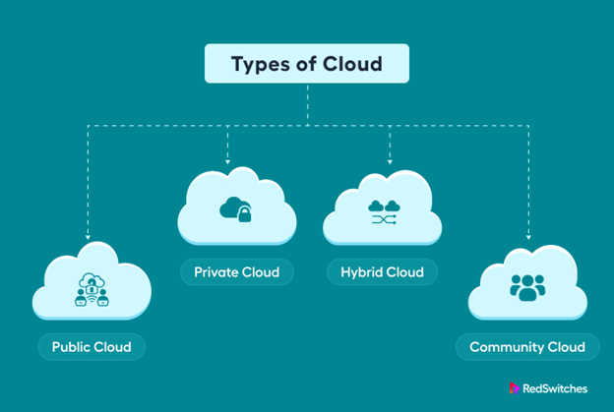
Cloud Models
What are the types of Cloud Models?
https://www.redswitches.com/wp-content/uploads/2023/05/Types-of-Cloud-Computing-Models-1.png

Slide 14
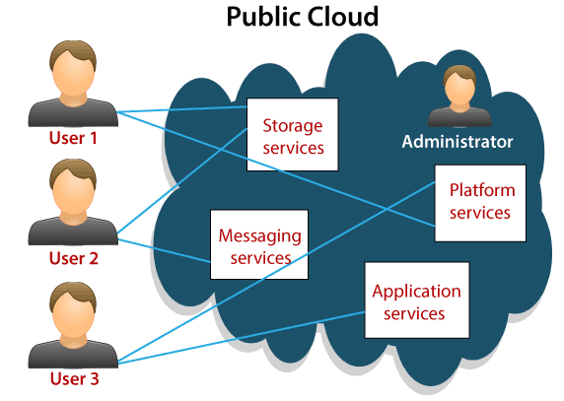
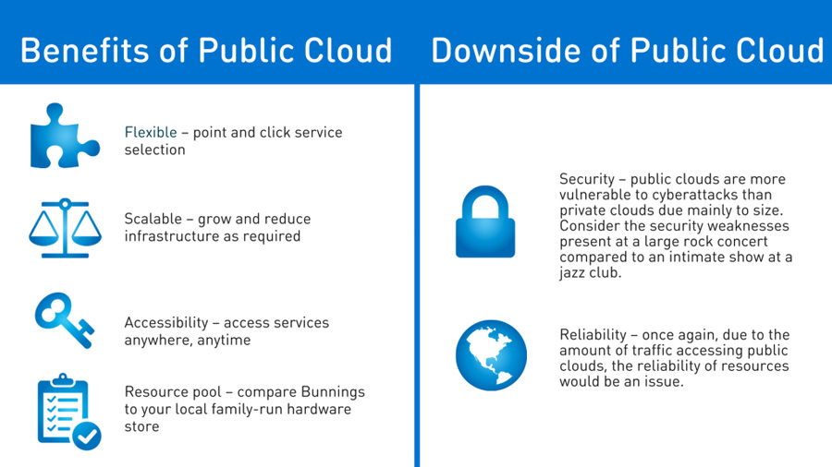
Cloud Models
What is Public Cloud?
https://www.tutorialandexample.com/wp-content/uploads/2019/11/Types-of-Cloud.png
What are the benefits and downside of Public Cloud??
https://digitalsense.com.au/wp-content/uploads/2018/07/benefits-public-cloud-hosting.jpg

Slide 15
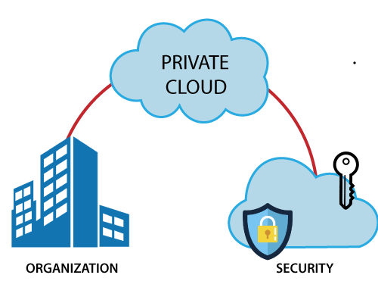
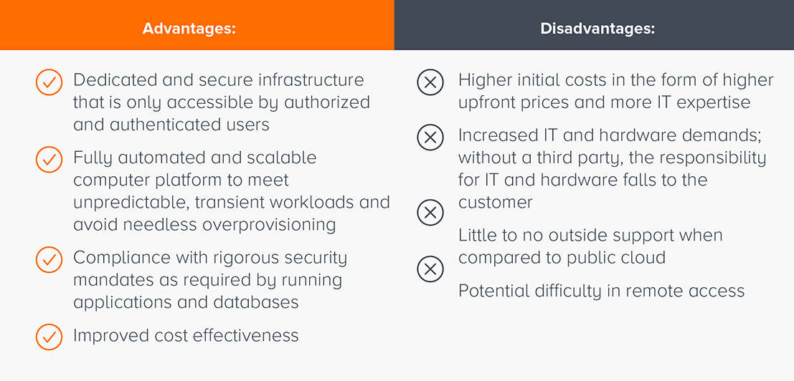
Cloud Models
What is Private Cloud?
https://static.javatpoint.com/cloudpages/images/privatecloud.png
What are the advantages and disadvantages of Private Cloud?
https://blog.gigamon.com/wp-content/uploads/2019/09/What-is-Private-Cloud_-Your-Data-with-a-Room-of-Its-Own-04.png

Slide 16
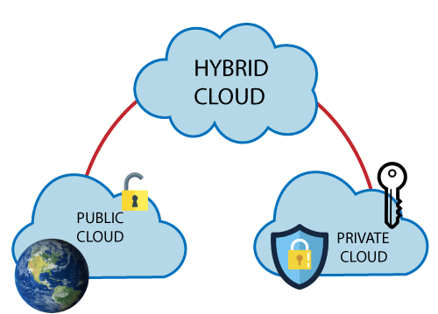
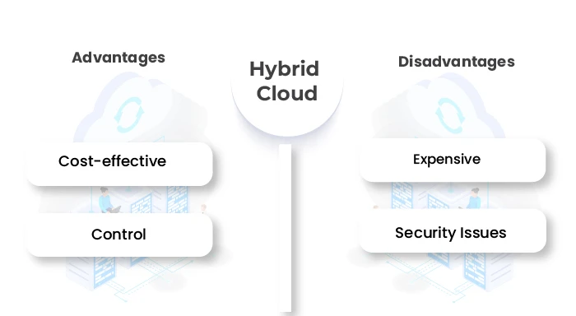
Cloud Models
What is Hybrid Cloud?
https://static.javatpoint.com/cloudpages/images/hybridcloud.png
What are the advantages and disadvantages of Hybrid Cloud?
https://custom-images.strikinglycdn.com/res/hrscywv4p/image/upload/c_limit,fl_lossy,h_9000,w_1200,f_auto,q_auto/12274826/232574_224062.jpg

Slide 17
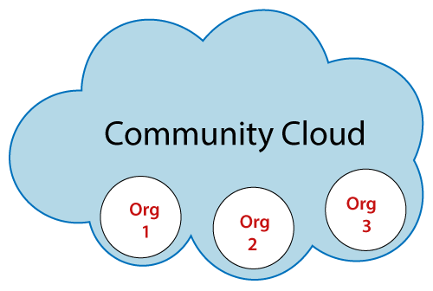
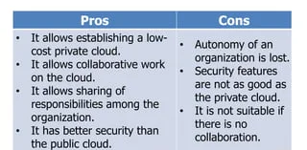
Cloud Models
What is Community Cloud?
https://static.javatpoint.com/cloudpages/images/community-cloud.png
What are the advantages and disadvantages of Community Cloud?
https://image.slidesharecdn.com/7-180228122029/85/cloud-deployment-model-20-320.jpg?cb=1668696885

Slide 18
Which cloud deployment model offers services to multiple organizations and can be managed by a third-party provider?
A) Public cloud
B) Hybrid cloud
C) Community cloud
D) Private cloud
What is a defining feature of a private cloud deployment?
A) Shared infrastructure
B) Accessibility to the general public
C) Dedicated resources for a single organization
D) Integration with community clouds
Which cloud model allows organizations to utilize both private and public clouds, allowing data and applications to be shared between them?
A) Public cloud
B) Hybrid cloud
C) Community cloud
D) Multi Cloud

Slide 19
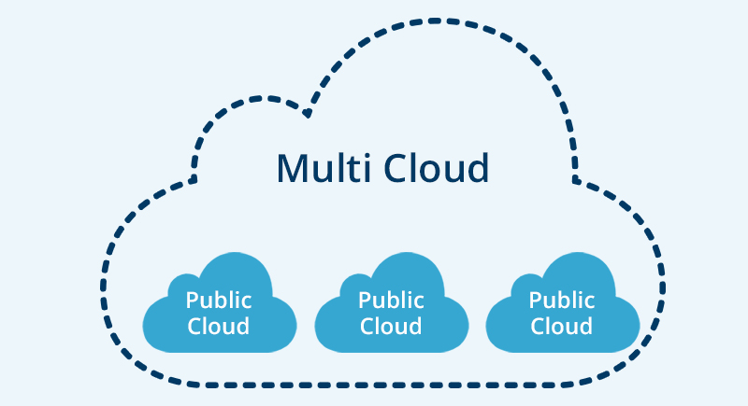
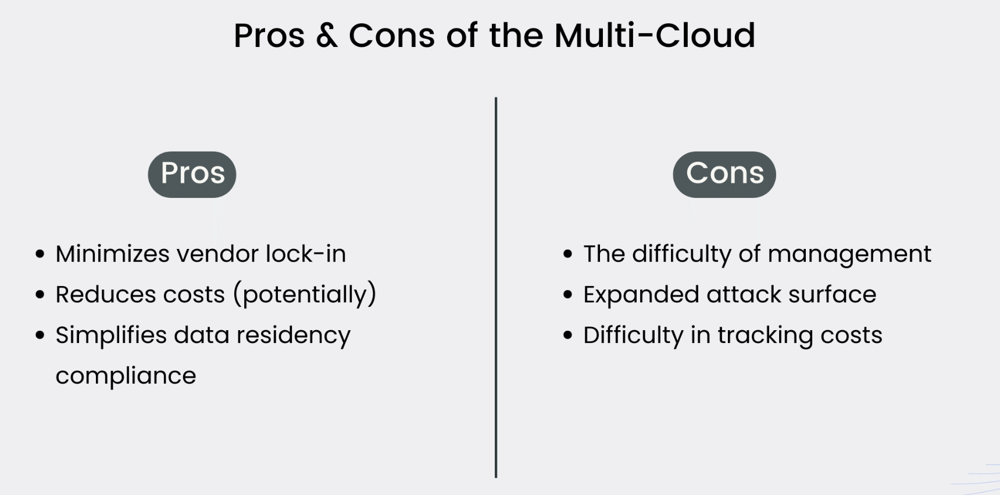
Cloud Models
What is Multi Cloud?
https://media.fs.com/images/community/upload/kindEditor/202201/28/2-1643358990-hlLITYat3A.jpg
What are the advantages and disadvantages of Multi Cloud?
https://assets-global.website-files.com/5f5097f276b52f2a32f9c27a/62ce8d32a47f6234a6af79f5_pros-and-cons-of-multicloud.png

Slide 20
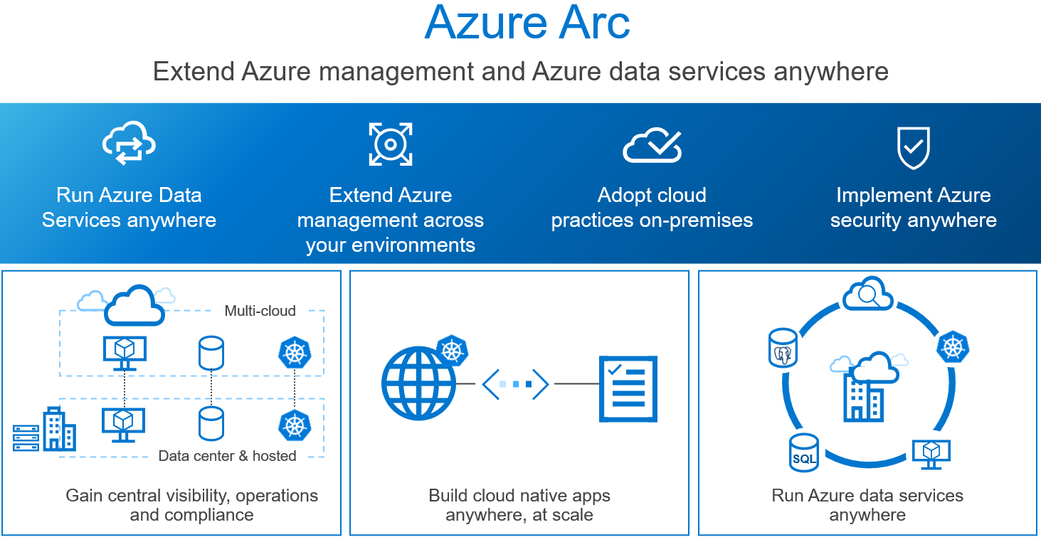
Cloud Models
What is Azure Arc?
Advantages
Hybrid flexibility
Unified management
Policy enforcement
Azure services extension
Disadvantages
Complexity
Dependency
Compatibility
https://www.devopsschool.com/blog/wp-content/uploads/2021/09/azure-arc.png

Slide 21
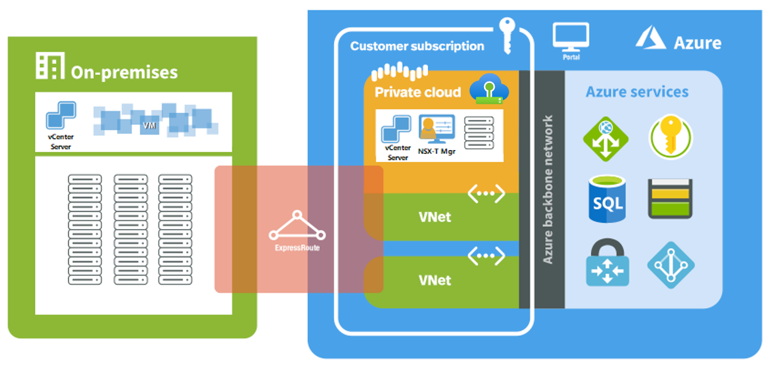
Cloud Models
What is Azure VMware Solution?
Advantages
Seamless Integration
Scalability
Hybrid Environment
Disadvantages
Complexity in Management
Dependency on Integration
Cost Considerations
Vendor Lock-in
https://learn.microsoft.com/en-us/azure/azure-vmware/media/introduction/adjacency-overview-drawing-final.png

Slide 22
What is Azure Arc primarily designed to do?
a) Manage only Azure-specific resources
b) Extend Azure services and management to any infrastructure
c) Provide security updates to Azure applications
d) Create isolated Azure environments
What does Azure VMware Solution aim to achieve?
a) Migrate Azure services to VMware environments
b) Migrate VMware workloads to Azure seamlessly
c) Replace VMware with Azure services
d) None of the above
Which of the following is a benefit of multi-cloud strategy?
a) Vendor lock-in
b) Increased flexibility and redundancy
c) Simplified data management
d) Decreased complexity in managing resources

Slide 23
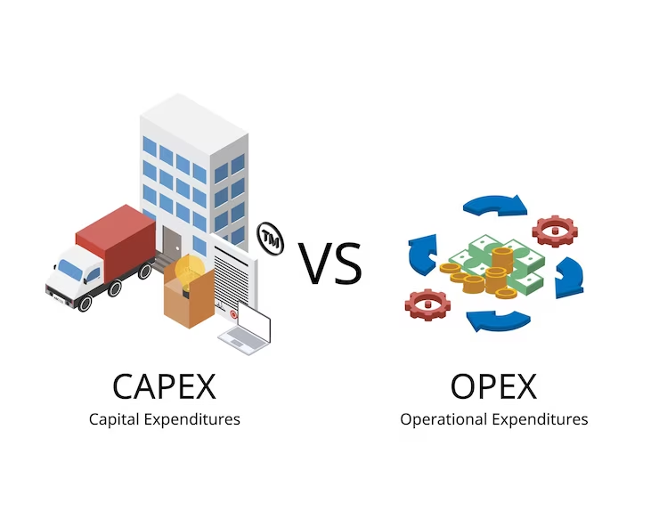
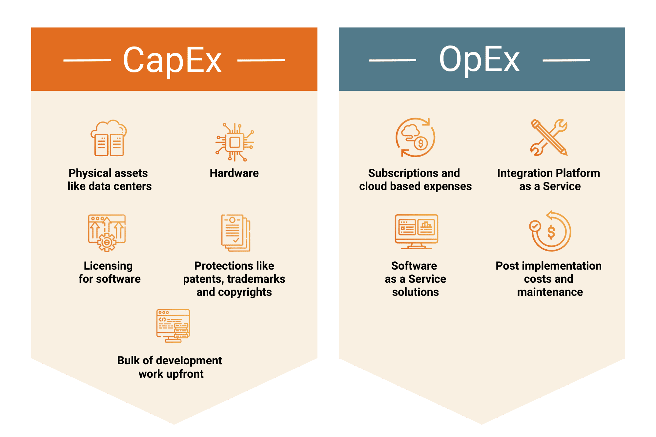
Consumption-Based Model
The consumption-based model in cloud computing is a billing approach where users are charged based on their actual usage of cloud resources, such as storage, processing power, or data transfer.
https://img.freepik.com/premium-vector/capital-expenditures-capex-operating-expenses-opex_518018-763.jpg?w=740
https://en.tigosolutions.com/Uploads/CapEx%20Vs.%20OpEx.png

Slide 24
What best describes the consumption-based model in cloud computing?
A) Fixed pricing for allocated resources
B) Paying for resources based on actual usage
C) Prepaid packages for services
D) Charging based on resource capacity
What advantage does the consumption-based model offer?
A) Predictable expenses
B) Fixed resource allocation
C) Cost-efficiency based on usage
D) High initial investment
In the consumption-based model, pricing is determined by:
A) The service provider's preference
B) Peak resource allocation
C) Amount of resources actually used
D) Annual subscription rates

Slide 25
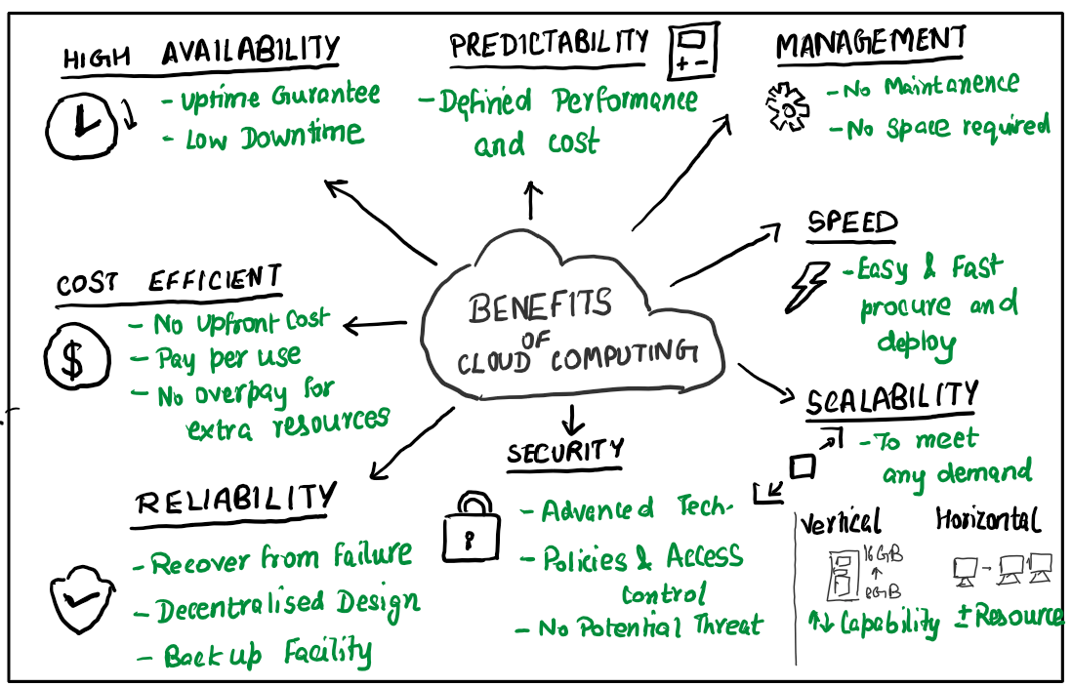
The Benefits of Cloud Computing
https://miro.medium.com/v2/resize:fit:1098/1*3AQbCe9AwS6IL9vzVxjeyg.png

Slide 26
What benefit of cloud computing allows for easy adjustments to resource needs?
A) Fixed resource allocation
B) Limited scalability
C) Elasticity
D) Upfront infrastructure investment
What cloud computing benefit provides enhanced disaster recovery capabilities?
A) Limited accessibility
B) Decreased flexibility
C) Built-in redundancy
D) On-premises limitation
Which advantage of cloud computing refers to the ability to access resources from anywhere with an internet connection?
A) Scalability
B) On-premises limitation
C) Ubiquitous access
D) Fixed resource allocation

Slide 27
Any Questions??

Slide 28
Thank You.

